Slide 1

BITS, PILANI – K. K. BIRLA GOA CAMPUS
Operating Systems
(IS ZC362)
by
Mrs. Shubhangi Gawali
Dept. of CS and IS
BITS, PILANI – K. K. BIRLA GOA CAMPUS

Slide 2
Lecture No. 8
Process Concept

Slide 3
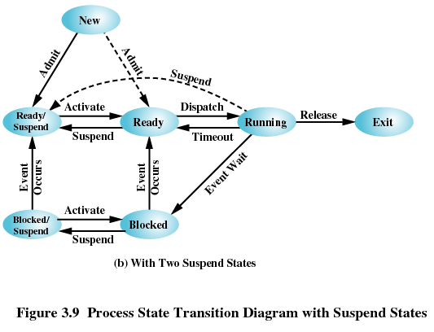

Slide 4

I/O | Mem | Proc- essor | State | Running | Ready | Ready-Susp | Blocked | Blocked-Susp
Yes | Yes | Yes | Running | - | Timeout | Mem not enough | Waiting for i/o | i/o and mem not available
Yes | Yes | No | Ready | Proc Available | - | Mem not enough | NA | NA
Yes | No | - | Ready- Suspend | NA | Mem available | - | NA | NA
No | Yes | - | Blocked | NA | i/o completed | NA | - | i/o and mem not available
No | No | - | Blocked- Suspend | NA | NA | i/o completed | mem available but waiting for i/o | -

Slide 5
I/O | Mem | Proc- essor | State | Running | Ready | Ready-Susp | Blocked | Blocked-Susp
Yes | Yes | Yes | Running | - | Timeout | Mem not enough | Waiting for i/o | NA
Yes | Yes | No | Ready | Proc Available | - | Mem not enough | NA | NA
Yes | No | - | Ready- Suspend | NA | Mem available | - | NA | NA
No | Yes | - | Blocked | NA | i/o completed | NA | - | i/o and mem not available
No | No | - | Blocked- Suspend | NA | NA | i/o completed | mem available but waiting for i/o | -

Slide 6
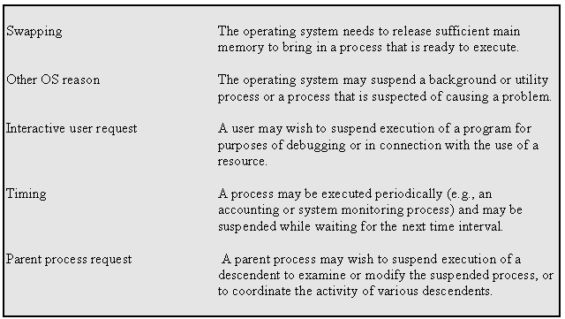

Slide 7
OS must have information about the current state of processes.
OS must have information about the current state of Resources in the system.
OS must keep track of utilization of resources by processes.
OS constructs and maintains tables (control structure) of information about each entity it is managing.
Notes:
The os controls the events within the computer system. It schedules and dispatches processes for execution by the processor, allocates resources to the processes and responds to the requests by user processes for basic services. So basically we can think of an os as the entity that manages the use of system resources by processes. So if os is to manage processes and resources, it must have information about the current status of each process and resource. Thus
OS must have information about the current state of processes.
OS must have information about the current state of Resources in the system.
OS must keep track of utilization of resources by processes.
OS constructs and maintains tables (control structure) of information about each entity it is managing.

Slide 8
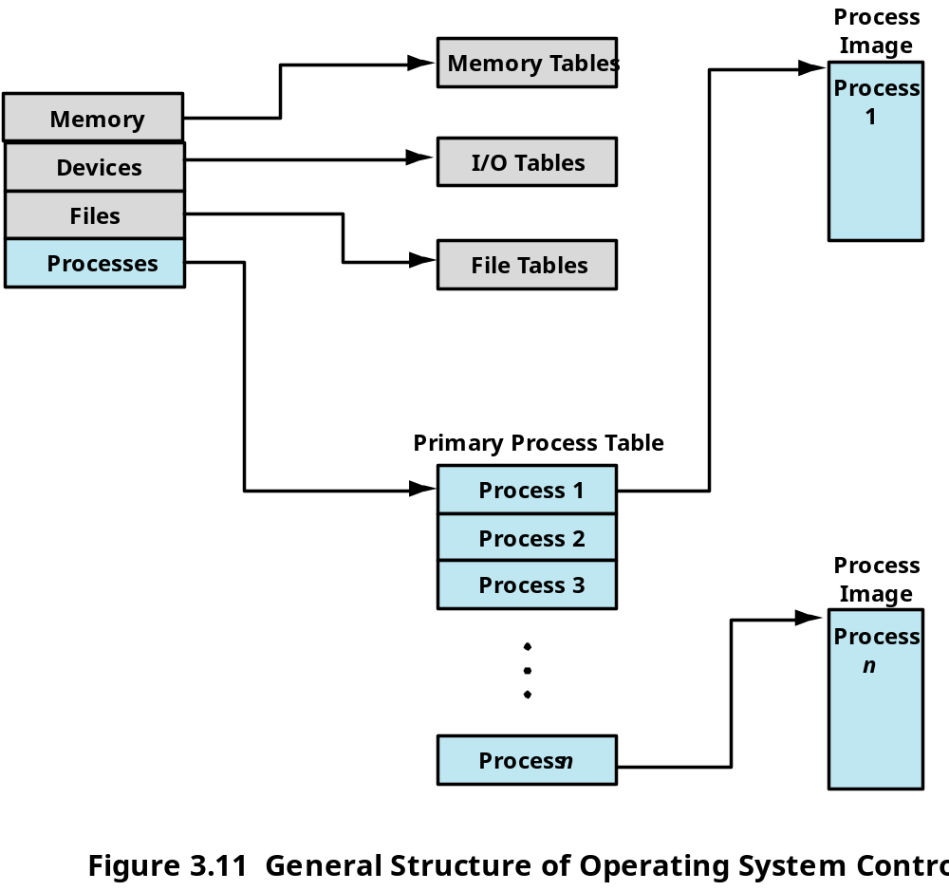
Notes:
Fig shows four diff types of tables maintained by the OS: memory, I/O, file and process.

Slide 9
Memory Tables keep track
  of allocation of main memory to processes
  of allocation of secondary memory to processes
  of protection attributes of main & secondary memory such as which processes can access certain shared memory region
  Information needed to manage virtual memory
I/O Table : keep track of allocation, availability and request of I/O resources
File Table : Provide information about
  Existence of file
  Location on secondary memory
  Current status and attributes of file
Process table : keep track of processes
Notes:
Memory tables are used to keep track of both main memory(real memory) and secondary memory(virtual memory).It also keeps track of protection attributes of main & secondary memory such as which processes can access certain shared memory region and also the information needed to manage virtual memory.
I/O tables are used to keep track of i/o devices meaning the allocation of i/o devices, availability and request of I/O resources. At a time an i/o device may be available to one particular process. If an i/o operation is in progress, the os needs to know the status of the i/o operation and the location in mm being used as the source or destination of the i/o transfer.
The os also maintains file tables. These table provide information about existence of file, location on secondary memory, current status and attributes of file.
Finally the os must maintain process table to manage processes.

Slide 10
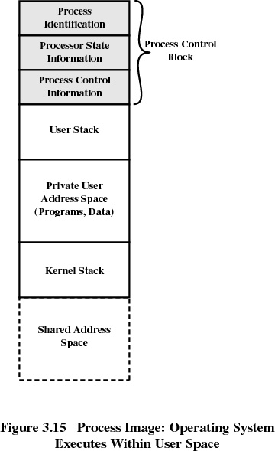
Notes:
Consider what an os has to know if os has to manage and control a process. First, it must know where the process is located, and second, it must know the attributes of the process that are necessary for its management(eg process id and process state)
As discussed earlier, a process is not only set of instructions to be executed but also it is associated with set of data locations for local and global variables and any defined constants. Thus, a process will consists of at least sufficient memory to hold the programs and data of that process. In addition, the execution of a program typically involves a stack that is used to keep track of procedure calls and parameter passing between procedures. Also, each process has associated with it a number of attributes that are used by the os for process control. This collection of attributes is referred to as process control block and …

Slide 11

A Process image consists of
  User Data
  User Program
  System Stack
  Process control block containing process attributes
Notes:
…..the collection of program, data, stack and attributes is referred to as process image.
The information of process attributes resides in process control block (PCB).

Slide 12

Process identification
Process state information
Process control information
Notes:
The process control block information is grouped into three general categories:
Process identification
Process state information
Process control information

Slide 13

Process id
Parent process id
Child process ids
User id
Group id(s)
Notes:
With respect to identification, each process is assigned a unique numeric identifier. This identifier is useful in several ways. Many of the other tables controlled by the OS may use process identifiers to cross-reference process tables. For example, the memory tables may be organized so as to provide a map of main memory with an indication of which process is assigned to each region. Similar references will appear in I/O and file tables. When processes communicate with one another, the process identifier informs the OS of the destination of a particular communication. When processes are allowed to create other processes, identifiers indicate the parent and descendents of each process. In addition to these process identifiers, a process may be assigned a user identifier that indicates the user responsible for the job. Similarly, a process may be assigned a group id to indicate the group to which the process is accessible.

Slide 14

User-Visible Registers
Control and Status Registers
  Program counter: Contains the address of the next instruction to be fetched
  Condition codes: Result of the most recent arithmetic or logical operation (e.g., sign, zero, carry, equal, overflow)
  Status information: Includes interrupt enabled/disabled flags, execution mode
Stack Pointers
  A stack is used to store parameters and calling addresses for procedure and system calls.
Notes:
Process state information consists of the contents of processor registers.
While a process is running, of course, the information is in the registers. When a
process is interrupted, all of this register information must be saved so that it can be
restored when the process resumes execution. The nature and number of registers
involved depend on the design of the processor. Typically, the register set will include
user-visible registers, control and status registers, and stack pointers.
User-Visible Registers
A user-visible register is one that may be referenced by means of the machine language that the processor
executes while in user mode. Typically, there are from 8 to 32 of these registers, although some RISC implementations
have over 100.
Control and Status Registers
These are a variety of processor registers that are employed to control the operation of the processor. These include
• Program counter: Contains the address of the next instruction to be fetched
• Condition codes: Result of the most recent arithmetic or logical operation (e.g., sign, zero, carry, equal, overflow)
• Status information: Includes interrupt enabled/disabled flags, execution mode
Stack Pointers
Each process has one or more last-in-first-out (LIFO) system stacks associated with it. A stack is used to store parameters
and calling addresses for procedure and system calls. The stack pointer points to the top of the stack.

Slide 15
Lecture No. 9
Process Concept

Slide 16

Scheduling and State Information
Data Structuring
Interprocess Communication
Process Privileges
Memory Management
Resource Ownership and Utilization
Notes:
The third major category of information in the process control block can be
called process control information. This is the additional information needed by the OS to control and
coordinate various active processes.
Scheduling and State Information
This is information that is needed by the operating system to perform its scheduling function. Typical items of
information:
• Process state: Defines the readiness of the process to be scheduled for execution (e.g., running, ready, waiting,
halted).
• Priority: One or more fields may be used to describe the scheduling priority of the process. In some systems,
several values are required (e.g., default, current, highest-allowable).
• Scheduling-related information: This will depend on the scheduling algorithm used. Examples are the
amount of time that the process has been waiting and the amount of time that the process executed the last
time it was running.
• Event: Identity of event the process is awaiting before it can be resumed.
Data Structuring
A process may be linked to other process in a queue, ring, or some other structure. For example, all processes in a waiting state for a particular priority level may be linked in a queue. A process may exhibit a parent-child (creator-created) relationship with another process. The process control block may contain pointers to other processes to support these structures.
Interprocess Communication
Various flags, signals, and messages may be associated with communication between two independent processes. Some or all of this information may be maintained in the process control block.
Process Privileges
Processes are granted privileges in terms of the memory that may be accessed and the types of instructions that may be executed. In addition, privileges may apply to the use of system utilities and services.
Memory Management
This section may include pointers to segment and/or page tables that describe the virtual memory assigned to this process.
Resource Ownership and Utilization
Resources controlled by the process may be indicated, such as opened files. A history of utilization of the processor or other resources may also be included; this information may be needed by the scheduler.

Slide 17
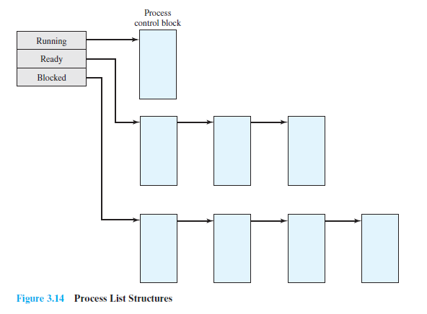

Notes:
As discussed before, the process control block may contain structuring
information, including pointers that allow the linking of process control blocks.
Thus, the queues that were described in the preceding section could be implemented
as linked lists of process control blocks. For example, the queuing structure can be implemented as shown in the figure.

Slide 18
Create a process
Destroy a process
Suspend a process
Resume a process
Change the priority number of a process
Block a process
Wakeup a process
Dispatch a process
Enable a process to communicate with another process

Slide 19

Name the process
Insert it in the process table(list of processes)
Determine the initial priority of the process
Create the PCB of newly created process
Initialize process control block
Allocate the initial resources to the process
Allocate space for the process
Set up appropriate linkages
        Ex: add new process to linked list used for scheduling queue
Create or expand other data structures
        Ex: maintain an accounting file

Slide 20
Parent process create children processes, which, in turn create other processes, forming a tree of processes.
Generally, process identified and managed via a process identifier (pid).

Slide 21

When to switch process?
Distinguish between mode switch and process switch
Modify corresponding data structures
Notes:
At some time, a running process is interrupted and the OS assigns another
process to the Running state and turns control over to that process.However, several
design issues are raised. First, what events trigger a process switch? Another issue is
that we must recognize the distinction between mode switching and process switching.
Finally, what must the OS do to the various data structures under its control to
achieve a process switch?

Slide 22

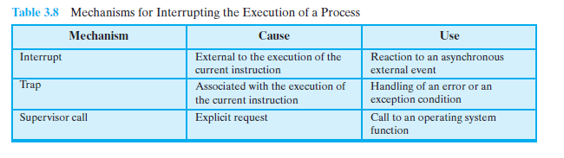
Notes:
A process switch may occur any time that the OS has gained control from the currently running process.
Table 3.8 suggests the possible events that may give control to the OS.
First, let us consider system interrupts. Actually, we can distinguish, as many
systems do, two kinds of system interrupts, one of which is simply referred to as an
interrupt, and the other as a trap. The former is due to some sort of event that is external
to and independent of the currently running process, such as the completion
of an I/O operation. The latter relates to an error or exception condition generated
within the currently running process, such as an illegal file access attempt. With an
ordinary interrupt, control is first transferred to an interrupt handler, which does some basic housekeeping and then branches to an OS routine that is concerned with the particular type of interrupt that has occurred.
Examples include the following:
• Clock interrupt: The OS determines whether the currently running process
has been executing for the maximum allowable unit of time, referred to as a
time slice. That is, a time slice is the maximum amount of time that a process
can execute before being interrupted. If so, this process must be switched to a
Ready state and another process dispatched.
• I/O interrupt: The OS determines what I/O action has occurred. If the I/O action
constitutes an event for which one or more processes are waiting, then the
OS moves all of the corresponding blocked processes to the Ready state (and
Blocked/Suspend processes to the Ready/Suspend state). The OS must then
decide whether to resume execution of the process currently in the Running
state or to preempt that process for a higher-priority Ready process.
• Memory fault: The processor encounters a virtual memory address reference
for a word that is not in main memory. The OS must bring in the block (page or
segment) of memory containing the reference from secondary memory to main
memory. After the I/O request is issued to bring in the block of memory, the
process with the memory fault is placed in a blocked state; the OS then performs
a process switch to resume execution of another process. After the desired
block is brought into memory, that process is placed in the Ready state.
With a trap, the OS determines if the error or exception condition is fatal. If so,
then the currently running process is moved to the Exit state and a process switch
occurs. If not, then the action of the OS will depend on the nature of the error and
the design of the OS. It may attempt some recovery procedure or simply notify the
user. It may do a process switch or resume the currently running process.
Finally, the OS may be activated by a supervisor call from the program being
executed. For example, a user process is running and an instruction is executed that
requests an I/O operation, such as a file open. This call results in a transfer to a routine
that is part of the operating system code. The use of a system call may place the
user process in the Blocked state.

Slide 23

If an interrupt is pending, the processor does the following:
1. It sets the program counter to the starting address of an interrupt handler program.
2. It switches from user mode to kernel mode so that the interrupt processing code may include privileged instructions.
Notes:
As a part of the instruction cycle, in the interrupt stage, the processor
checks to see if any interrupts are pending, indicated by the presence of an interrupt
signal. If no interrupts are pending, the processor proceeds to the fetch stage and
fetches the next instruction of the current program in the current process. If an interrupt
is pending, the processor does the following:
1. It sets the program counter to the starting address of an interrupt handler
program.
2. It switches from user mode to kernel mode so that the interrupt processing
code may include privileged instructions.
The processor now proceeds to the fetch stage and fetches the first instruction of the
interrupt handler program, which will service the interrupt. At this point, typically,
the context of the process that has been interrupted is saved into that process
control block of the interrupted program.
So What constitutes the context that is saved?
it must include any information that may be altered by
the execution of the interrupt handler and that will be needed to resume the program
that was interrupted. Thus, the portion of the process control block that was
referred to as processor state information must be saved. This includes the program
counter, other processor registers, and stack information.

Slide 24

Save the context of the processor.
Update the process control block of the process,
Move the process control block of this process to the appropriate queue
Select another process for execution
Update the process control block of the process selected
Update memory management data structures
Restore the context of the processor
Notes:
It is clear, then, that the mode switch is a concept
distinct from that of the process switch. A mode switch may occur without changing
the state of the process that is currently in the Running state. In that case, the
context saving and subsequent restoral involve little overhead. However, if the currently
running process is to be moved to another state (Ready, Blocked, etc.), then
the OS must make substantial changes in its environment. The steps involved in a
full process switch are as follows:
1. Save the context of the processor, including program counter and other
registers.
2. Update the process control block of the process that is currently in the Running
state. This includes changing the state of the process to one of the other states
(Ready; Blocked; Ready/Suspend; or Exit). Other relevant fields must also be
updated, including the reason for leaving the Running state and accounting
information.
3. Move the process control block of this process to the appropriate queue (Ready;
Blocked on Event i;Ready/Suspend).
4. Select another process for execution; this topic is explored in Part Four.
5. Update the process control block of the process selected.This includes changing
the state of this process to Running.
6. Update memory management data structures.This may be required, depending
on how address translation is managed; this topic is explored in Part Three.
7. Restore the context of the processor to that which existed at the time the selected
process was last switched out of the Running state, by loading in the
previous values of the program counter and other registers.
Thus, the process switch, which involves a state change, requires more effort
than a mode switch.

Slide 25
Process Management
• Process creation and termination
• Process scheduling and dispatching
• Process switching
• Process synchronization and support for interprocess communication
• Management of process control blocks
Memory Management
• Allocation of address space to processes
• Swapping
• Page and segment management

Slide 26
I/O Management
• Buffer management
• Allocation of I/O channels and devices to processes
Support Functions
• Interrupt handling
• Accounting
• Monitoring

Slide 27


Slide 28
Parent process create children processes, which, in turn create other processes, forming a tree of processes
Generally, process identified and managed via a process identifier (pid)
Resource sharing
  Parent and children share all resources
  Children share subset of parent’s resources
  Parent and child share no resources
Execution
  Parent and children execute concurrently
  Parent waits until children terminate

Slide 29
Address space
  Child duplicate of parent
  Child has a program loaded into it
UNIX examples
  fork system call creates new process
  exec system call used after a fork to replace the process’ memory space with a new program

Slide 30
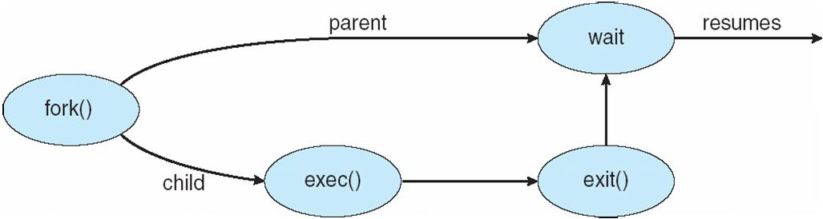

Slide 31

If fork() returns a negative value, the creation of a child process was unsuccessful.
fork() returns a zero to the newly created child process.
fork() returns a positive value, the process ID of the child process, to the parent.

Slide 32
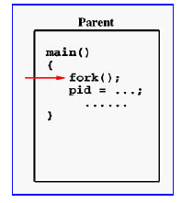
Notes:
If the call to fork() is executed successfully, Unix will
make two identical copies of address spaces, one for the parent and the other for the child.
Both processes will start their execution at the next statement following the fork() call. In this case, both processes will start their execution at the assignment statement as shown.

Slide 33
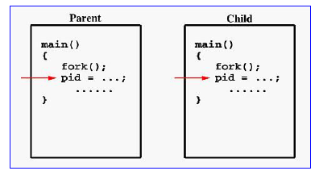
Notes:
Both processes start their execution right after the system call fork(). Since both processes have identical but separate address spaces, those variables initialized before the fork() call have the same values in both address spaces. Since every process has its own address space, any modifications will be independent of the others. In other words, if the parent changes the value of its variable, the modification will only affect the variable in the parent process's address space. Other address spaces created by fork() calls will not be affected even though they have identical variable names.

Slide 34
#include <stdio.h> #include <sys/types.h> void ChildProcess(void); void ParentProcess(void); void main(void) { pid_t pid; pid = fork(); if (pid == 0) ChildProcess(); else ParentProcess(); } | void ChildProcess(void) { int i; for (i =1; i<= 10; i++) printf(“child, i=%d\n", i); printf(“child done \n"); } | void ParentProcess(void) { int i; for (i=1; i<= 10; i++) printf(“parent, i= %d\n", i); printf(“parent done\n"); }
Notes:
In this program, both processes print lines that indicate (1) whether the line is printed by the child or by the parent process, and (2) the value of variable i. For simplicity, printf() is used.

Slide 35
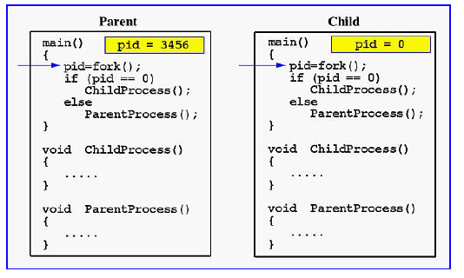
Notes:
When the main program executes fork(), an identical copy of its address space, including the program and all data, is created. System call fork() returns the child process ID to the parent and returns 0 to the child process. The following figure shows that in both address spaces there is a variable pid. The one in the parent receives the child's process ID 3456 and the one in the child receives 0.

Slide 36
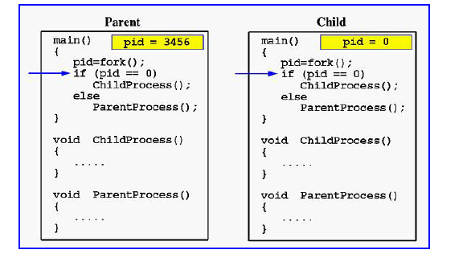
Notes:
Now both programs (i.e., the parent and child) will execute independent of each other starting at the next statement:

Slide 37
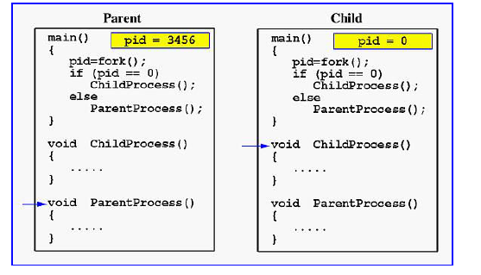
Notes:
In the parent, since pid is non-zero, it calls function ParentProcess(). On the other hand, the child has a zero pid and calls ChildProcess() as shown.
Due to the fact that these processes are run concurrently, their output lines are intermixed in a rather unpredictable way. Moreover, the order of these lines are determined by the CPU scheduler. Hence, if you run this program again, you may get a totally different result.
Due to the fact that the CPU scheduler will assign a time quantum to each process, the parent or the child process will run for some time before the control is switched to the other and the running process will print some lines before you can see any line printed by the other process.

Slide 38
#include <stdio.h>
#include <unistd.h>
#include <errno.h>
#include <sys/types.h>
int main(){
pid_t pid;
printf(“fork program starting \n”);
pid = fork();
if (pid < 0 ){ perror(“fork failed\n”); exit(1); }
else if (pid == 0){
printf(“ This is from child process My PID is %d and my Parent PID is %d\n”,getpid(),getppid()); }
else { printf(“This is from parent process My PID is %d and my Child’s PID is %d\n”,getpid(),pid); wait(NULL); } // common to parent and child
return 0;
}

Slide 39
Each process is allowed to have a unique number named process identifier or PID
  usually between 2 and 32767 (/proc/sys/kernel/pid_max)
  64 bit → maximum PID number up to 4194303
Next unused number is chosen as process ID
Once upper limit of 32767 is reached then the numbers restart at 2 so that they wrap around.
PID 1 is init process, Process 0 is swapper or sched (Process 0 is responsible for paging)
Process has its own code, data, stack, environment space, program counter etc.
Process table contains information about all the processes that are currently loaded with

Slide 40
fork
pid_t fork(void)
  Duplicates the current process, creating a new entry in the process table with many of the same attributes as the parent process.
  The new process is almost identical to the original, executing the same code but with its own data space, environment and file descriptor.
  Uses copy on write technique
  Kernel internally invokes do_fork() function (in fork.c)

